Slide 1


THRIVE: PROMOTING PHYSICAL ACTIVITY FOR MENTAL WELL-BEING
Honours Individual Student Project
Andy Lopez Suarez
Notes:
Hi my names Andy and I will be talking about my honours individual project.

Slide 2
Objectives
Create
Create a collaborative fitness tracking game
Support
Support physical activity to combat negative effect on mental wellbeing and the decline in physical activity due to COVID-19
Evaluate
Evaluate if the mobile app had a positive effect on mental wellbeing
Notes:
The initial objectives for this project was to create a multiplayer step tracking game.
My dissertation focuses on what effect the Covid 19 pandemic has had
on physical activity and mental wellbeing and how this can be mitigated.
This will be done by using a collaborative and gamified approach, which has shown to be more effective In promoting physical activity compared to using an individual general approach
Lastly, the project aims to evaluate if the mobile app was effective in having a positive impact on the mental wellbeing of participants.

Slide 3
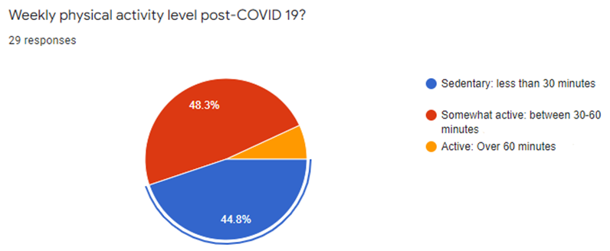
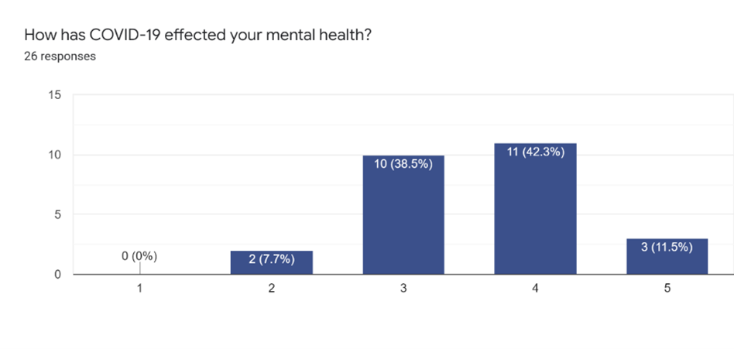
COVID-19 Impact Survey
Physical activity impact
Before pandemic: 24%
After pandemic: 44%
20% increase in sedentary behavior
Mental health impact
42% negative impact
7% positive impact
Notes:
At the start of the project I sent out an survey to find out how people’s mental health and physical activity was impacted because of the pandemic.
The world health organization recommends 30 minutes of moderate exercise each day.
Sedentary behaviour is classified as doing less than 30 minutes of activity per week.
Before the pandemic, 24% of people were classified as living a sedentary lifestyle.
This reflects research showing there has been a global increase in sedentary behaviour in people due factors such as motorized transport..
After the pandemic there had been a 20% increase in sedentary behaviour among the 29 adults asked.
This can be attributed to quarantine measures and work from home guidelines.
When asked about what impact the pandemic had on their mental wellbeing.
42% of participants assessed that they had experienced a negative impact
and a further 11% saying it had a very negative impact.
There were some individuals, as seen on the graph, that saw a positive impact on their mental wellbeing.
Research has shown that supporting people to be more physical active helps reduce anxiety and depression levels, with just as little as 10 minutes of weekly physical activity making a difference.
Furthermore, there was evidence showing that regular physical activity reduces the severity of covid-19 and mortality rate,
again people have to do 10 minutes of weekly activity see this.

Slide 4
Features to support behaviour change
Team setting
Collective goals
Rewards
Self defined goals
Notes:
From the background research carried out:
I found that implementing these four features is an effective way to support a user adopt healthy habits
Team setting, collective goals, rewards, self defined goals
A team setting has shown to encourage physical activity more than in an individual setting.
Having a team also fosters competitiveness and people that are competitive have been shown to engage more.
By setting a collective goal a team can build a sense of community and it has shown improve performance.
A user has to be rewarded for positive behaviour- in our case reaching the collective goal.
A goal has to be achievable for the user or else they wont be motivated to change their behaviour. This means goals have to be self defined by a and there should not be a one size fits all goal .
These features were incorporated into the app to promote regular physical activity.

Slide 5
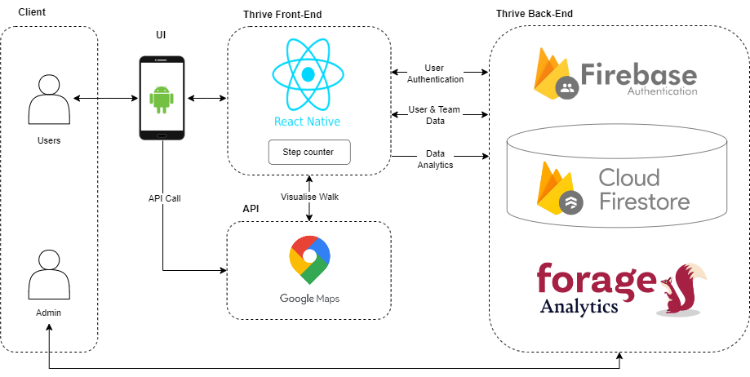
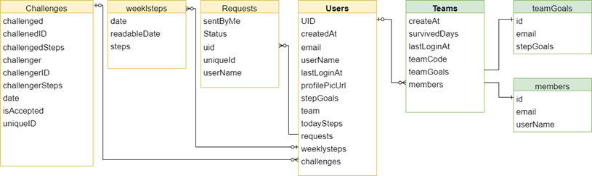
Implementation
Back-end Implementation
Firebase
Forage
Front-end Implementation
React Native
Google Maps
Step Counter
Notes:
For the project an iterative model was used. This was used to break down the requirements into manageable goals and steadily the mobile application evolves until the final product is developed. There was 10 iterations each lasting 2 week.
For the backend I chose to use Firebase. Firebase is a serverless framework that is developer friendly and offers a range of services such as authentication and data analysis. It improves development time significantly and is suitable for small scale projects that have a short deliver timeline.
The system architecture can be seen on the slide and below is a diagram of the database structure for the application.
For the front-end I chose to use react native to develop the application. It is a popular cross-platform mobile development framework. It reduces development speed, is easy to work with and has a large community. To track the physical activity, I used a react native package that uses a devices sensors to get the step count. Google Maps was used to let players view their walking route. .

Slide 6
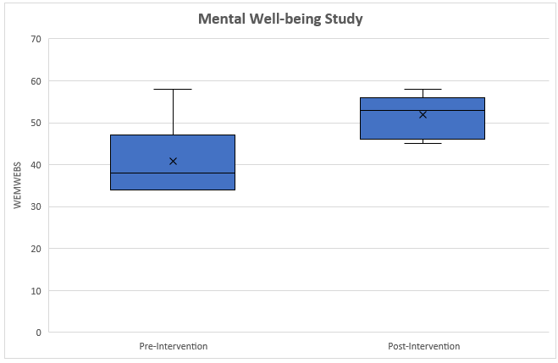
Evaluation Results
Warwick-Edinburgh Mental Wellbeing Scale
Statistically significant increase of 11 points
89% usability score
Interview- competitiveness, health benefits
Notes:
To eval the mental wellbeing of participants completed the Warwick Edinburgh mental wellbeing survey.
It is a positively worded 14 Likert-style survey that has a high validity.
A main goal of the evaluation was to see if there was a positive to the mental wellbeing of participants after using the app.
The results were analysed and showed that there was indeed a statistically significant increase in the mental wellbeing score.
The usability of the application was also analysed and it scored a mean average of 86% which shows a high usability.
This can be attributed to following Nielsen’s 10 heuristic.
After the study participants were interviewed and a player noted how walking encourages them to adopt other healthy habits, like making more time for themselves. Competitive players commented how they were engaged in the minichallenges more than non competitive players. Player noted how it

Slide 7
Conclusion
Physical activity lead to a positive increase in mental wellbeing score
A longer study needs to be carried out and the clinical significance should be investigated with a larger sample of participants
Improvements to application: refine step counter, Cloud Storage, add long term rewards from points gathered by players

Slide 8
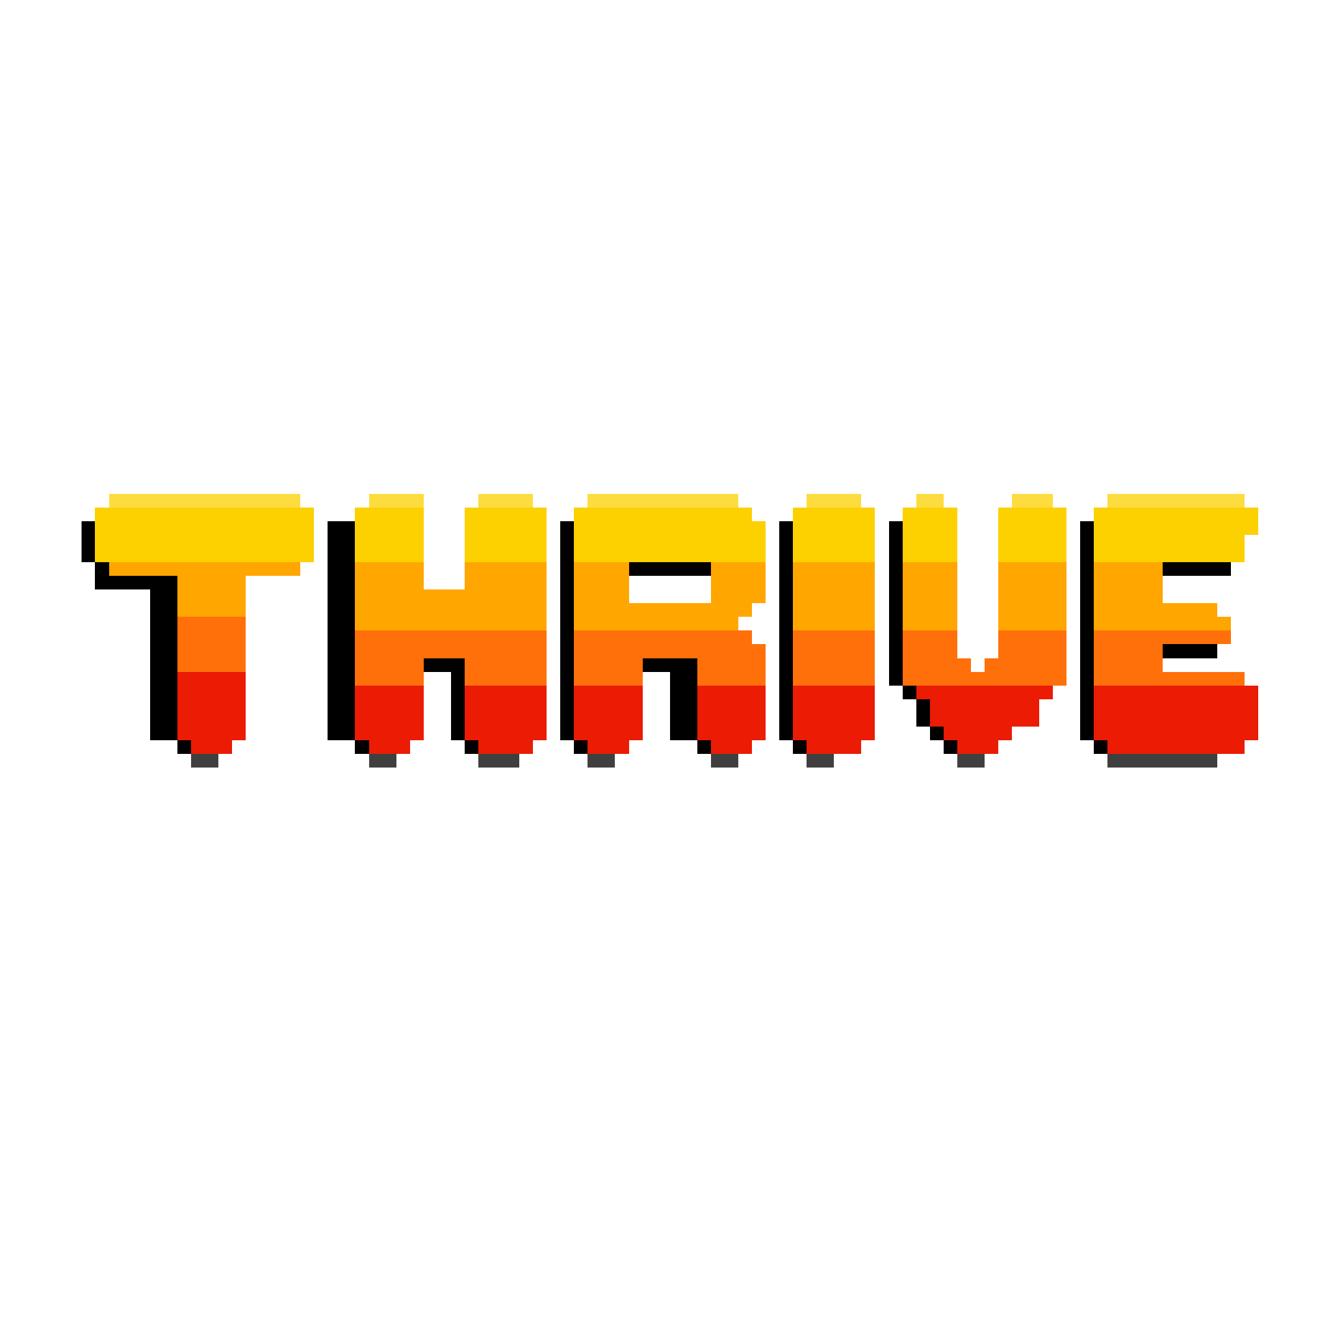
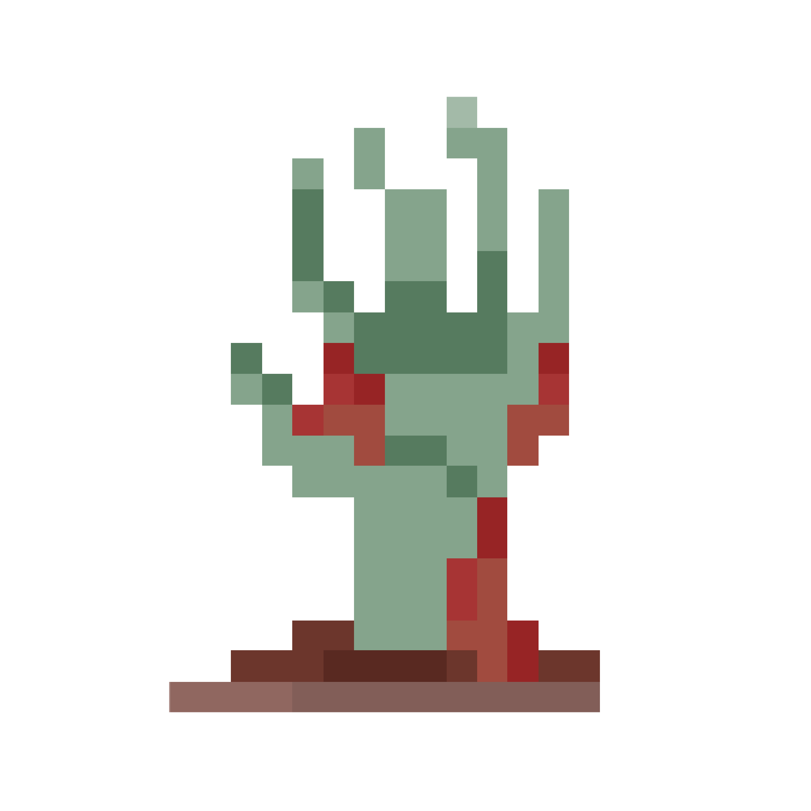
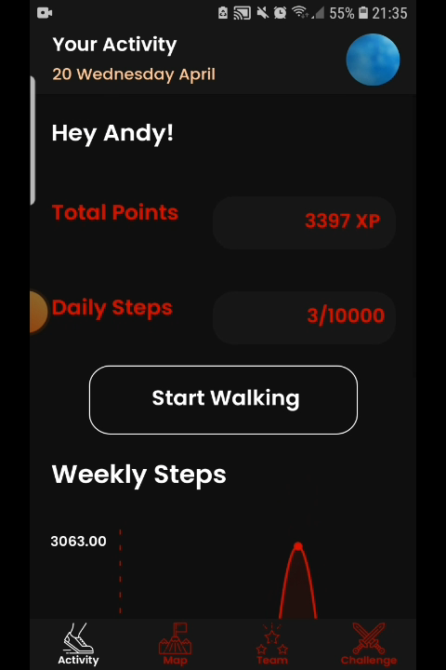
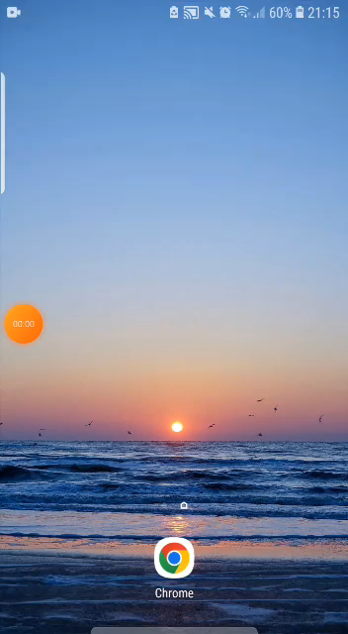
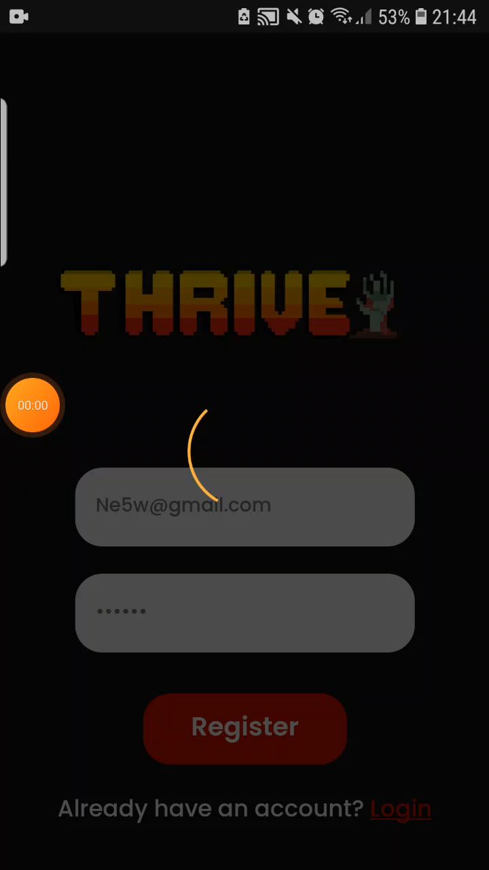
Demonstration
Step Tracker
App Walkthrough
Join a team
Notes:
For my project I created a social fitness game called Thrive.
It lets a four player team to walk together towards a collective step goal.
I chose walking as the form of physical activity because it’s a popular aerobic exercise that is suitable for a wide range of people.
The game has an underlying narrative that was chosen to engage people in the game.
Players are able to view their physical activity data and challenge other team members in a mini game.
The mini game is 10 minutes long and was created to encourage players to reach towards their
A team has to reach the step goal before the next day and if they do they get to continue walking.
If they don’t make it their team looses.
four players to walk as a team and work towards a collective step goal.

